Slide 1


Slide 2
When we look at
Massachusetts as a whole, there is much to celebrate

Slide 3
Key Education Indicators
High School Graduation | Percentage of 9th graders in MA public high schools who graduate high school within four years
College Enrollment | Percentage of Massachusetts public high school graduates who enroll in college within 16 months after high school graduation
Public College Graduation | Percentage of first-time, degree-seeking students who initially enroll at a Massachusetts public college or university and graduate from any U.S. higher education institution within six years
Overall College Attainment | Percentage of Massachusetts residents (age 25+) who possess a college degree (associate or higher)

Slide 4
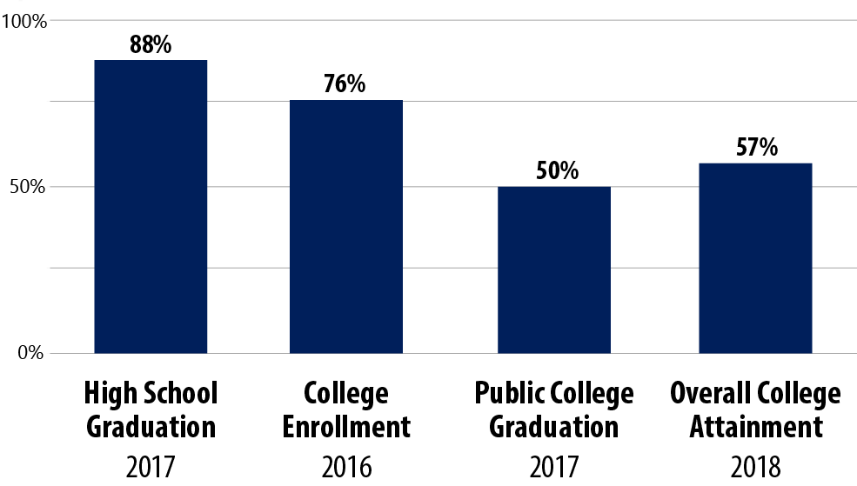

Massachusetts tops the nation in many key education indicators
MA Key Education Indicators: Statewide

Slide 5
But a closer look at these indicators by race/ethnicity and gender tells a different story

Slide 6
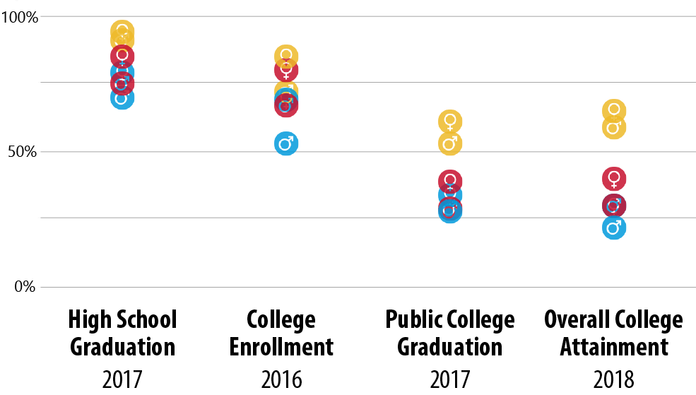
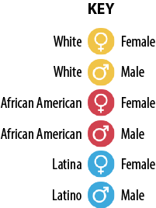
The rates vary significantly by race/ethnicity and gender
MA Key Education Indicators: By Race/Ethnicity & Gender
MA
MA
MA
MA

Slide 7
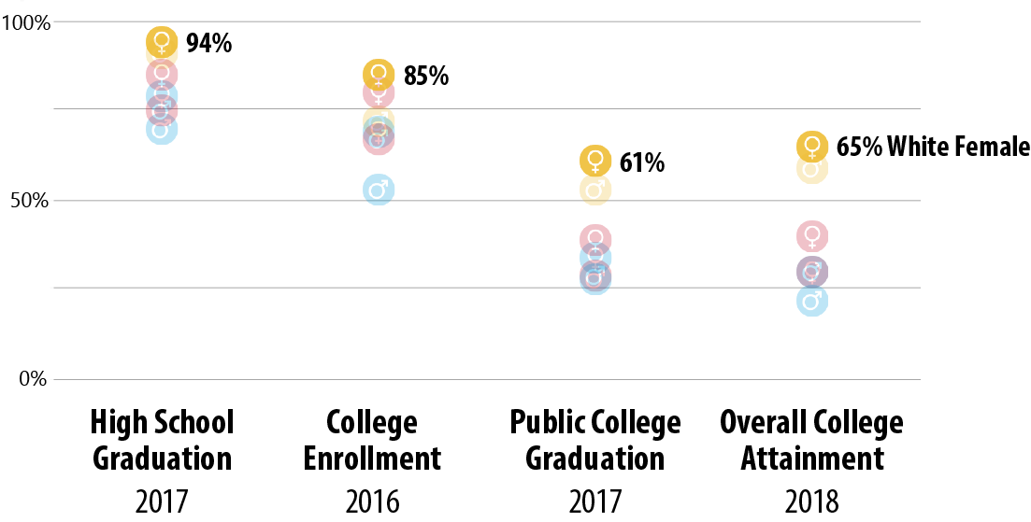
White females consistently rank at the top of their peers
MA Key Education Indicators: By Race/Ethnicity & Gender

Slide 8
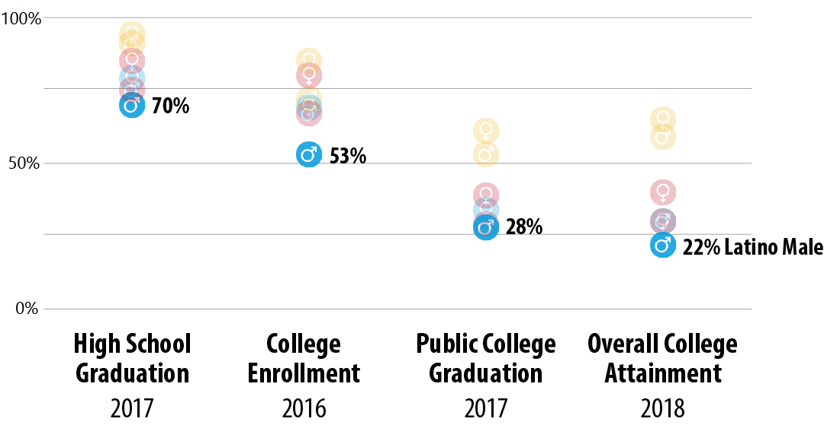
And Latino males consistently rank at the bottom
MA Key Education Indicators: By Race/Ethnicity & Gender

Slide 9
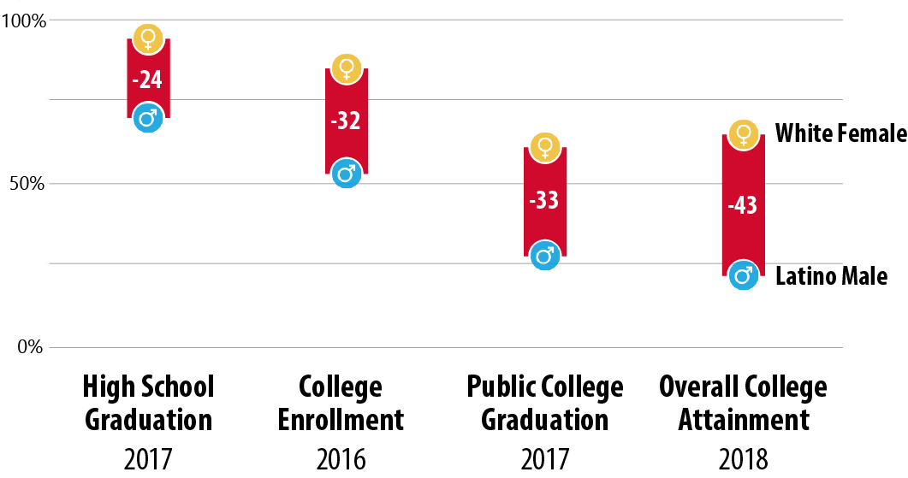
The gaps are large
MA Key Education Indicators: By Race/Ethnicity & Gender

Slide 10
Coupled with population projections for Massachusetts, these findings give even more cause for concern

Slide 11
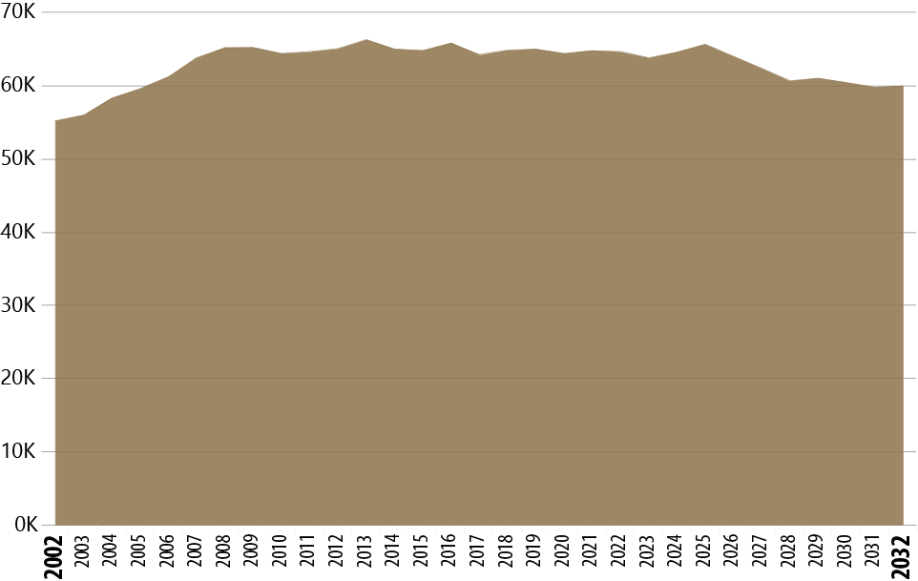
Not only will Massachusetts be seeing a decline in overall numbers of HS grads…
MA Public HS Graduating Classes
Today

Slide 12
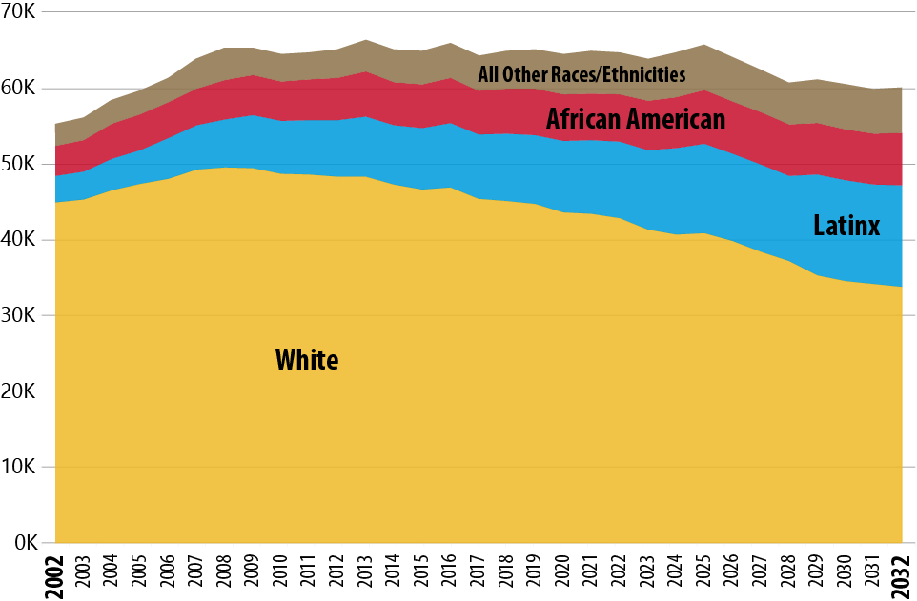
… but Latinx students also represent a rapidly growing segment of the pipeline
MA Public HS Graduating Classes: By Race/Ethnicity

Slide 13
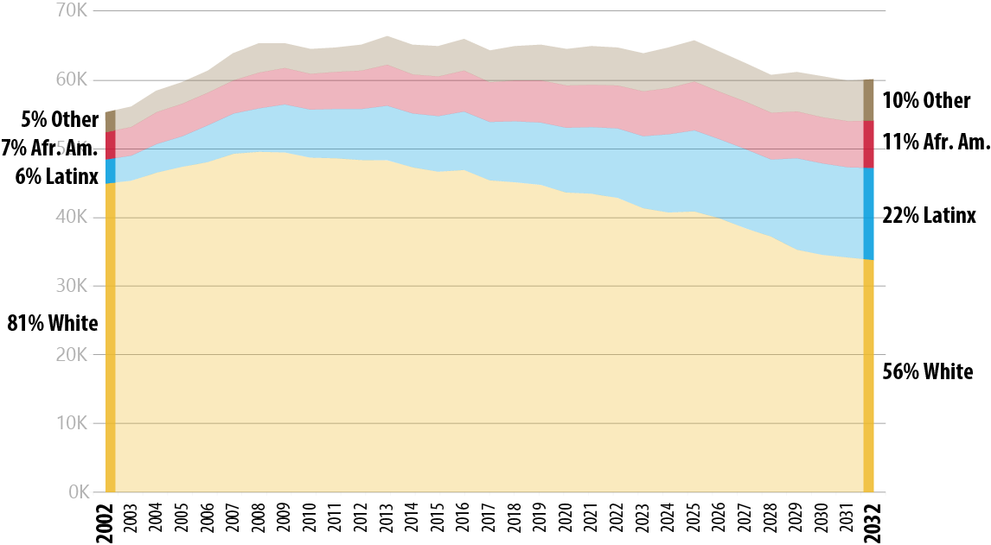
By 2032, more than 1 in 5 students in the pipeline will be Latinx
MA Public HS Graduating Classes: By Race/Ethnicity

Slide 14
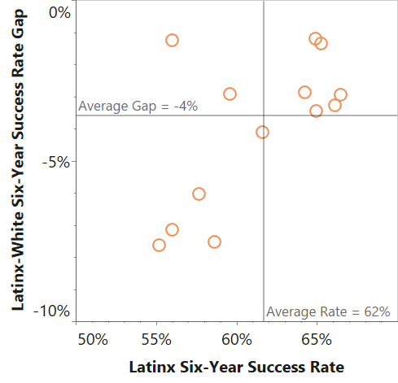
Community Colleges: Latinx-White Gaps
Lower Success Rate
Higher Success Rate
Smaller Gap
Larger Gap

Slide 15
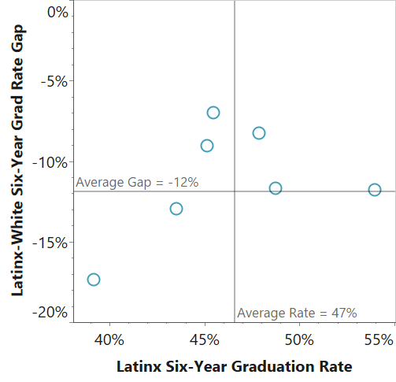
State Universities: Latinx-White Gaps
Lower Success Rate
Higher Success Rate
Smaller Gap
Larger Gap

Slide 16
Additional Background

Slide 17
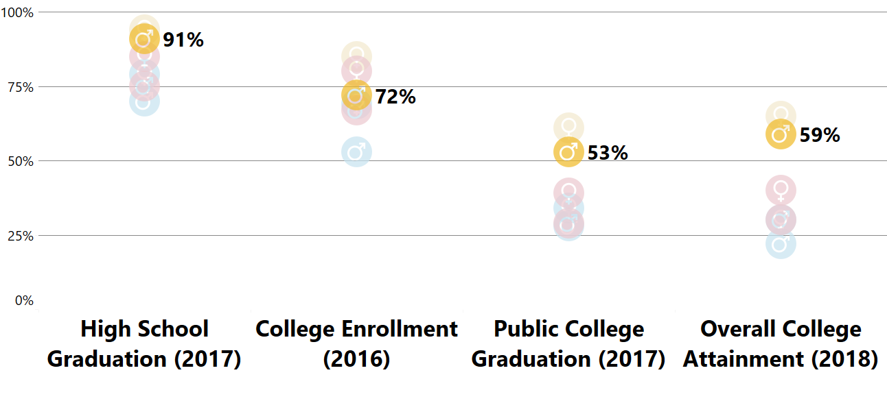
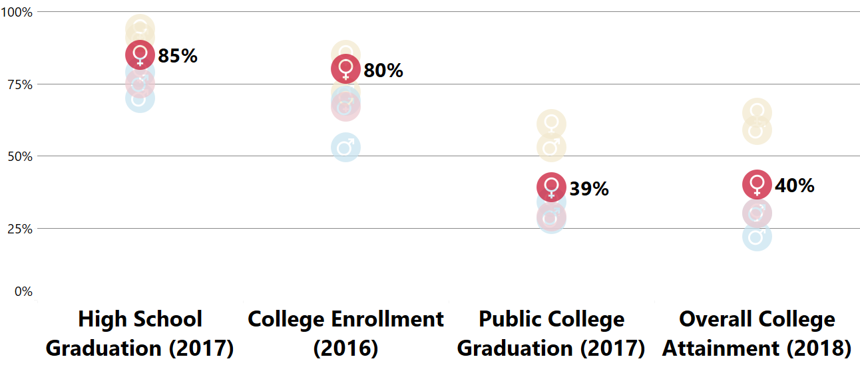
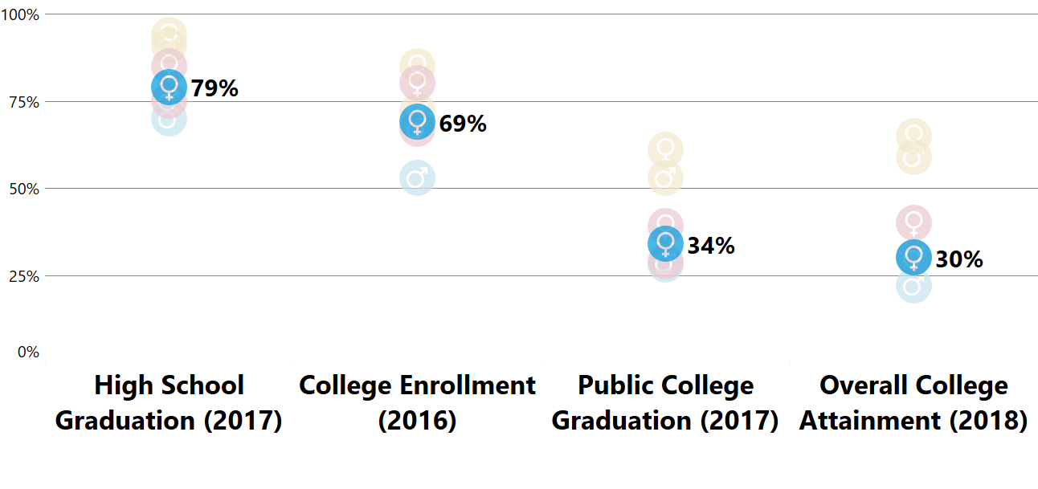
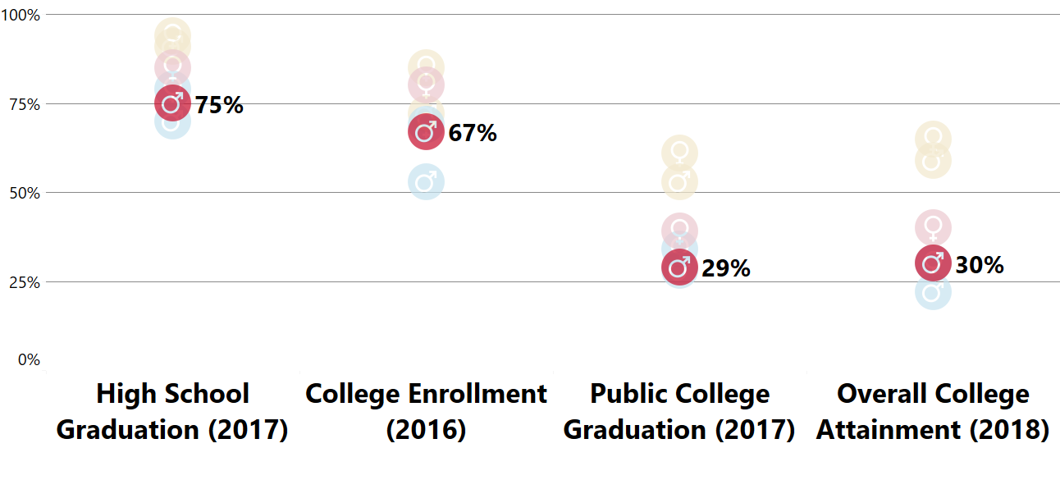
Additional Detail: Key Education Indicators
Equity Statewide Strategic Framework
White Male
African American Female
Latina Female
African American Male

